Slide 1
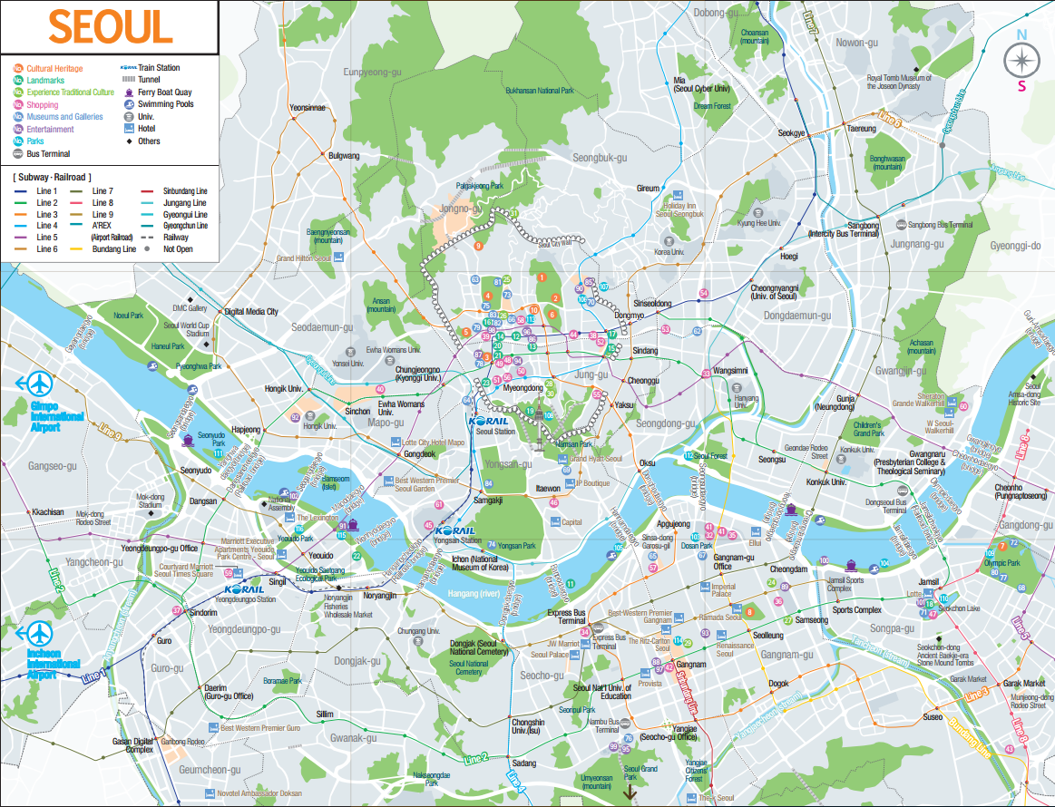
Analysis of Spatial Density
Utilizing the Big Data of
Floating Population of Seoul City
HANKUK ACADEMY OF FOREIGN STUDIES
Hailin Kim

Slide 2
Analysis of Spatial Density Utilizing the Big Data of Floating Population of Seoul City
CONTENTS
1
GOAL OF ANALYSIS
5
ANALYSIS OF SPATIAL DENSITY OF FOREIGN TOURISTS IN SEOUL CITY
6
ANALYSIS OF SPATIAL DENSITY OF FOREIGN TOURISTS IN PRINCIPAL AREAS
2
SUBJECT OF ANALYSIS
3
ANALYSIS SOFTWARE
7
APPLICATIONS
4
ANALYSIS PROCESS

Slide 3
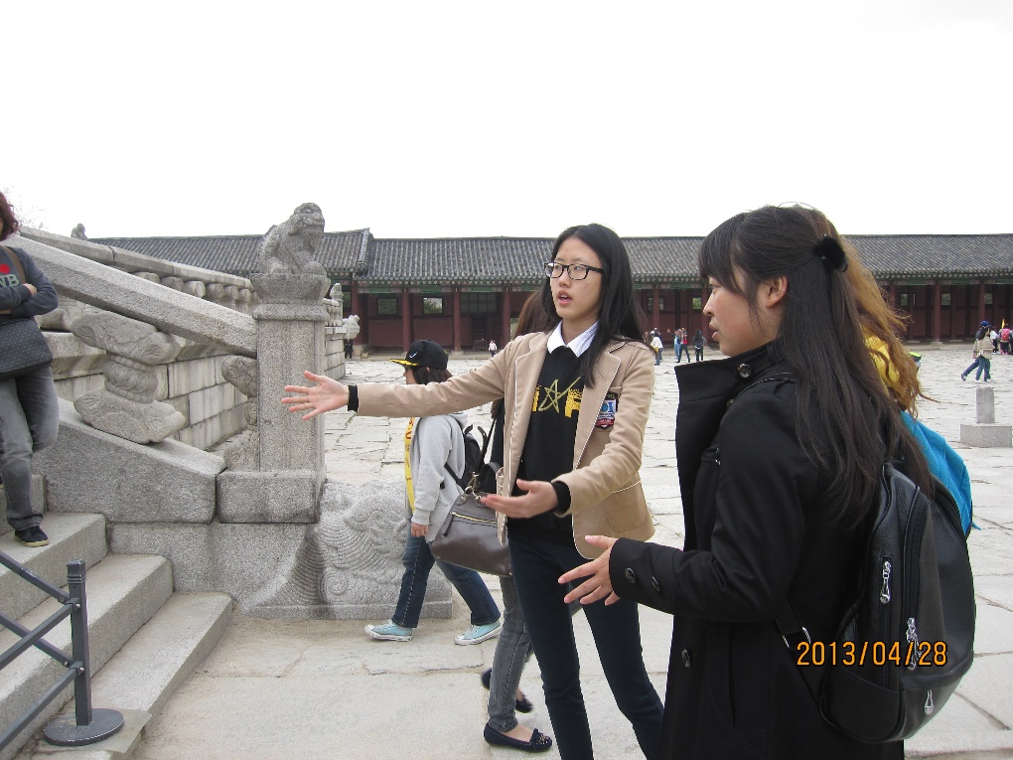

Slide 4
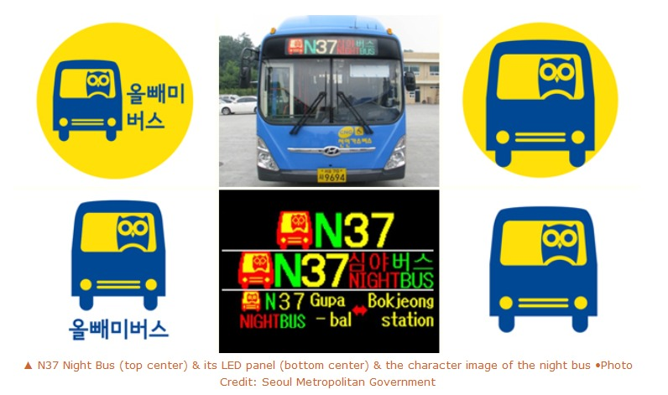
GOAL OF ANALYSIS
Analysis Software
Subject of Analysis
Analysis Process
Analysis Spatial Density of Foreign Tourists in Seoul City
Analysis Spatial Density of Foreign Tourists in Principal Areas
Applications
Seoul City’s OWL BUS

Slide 5
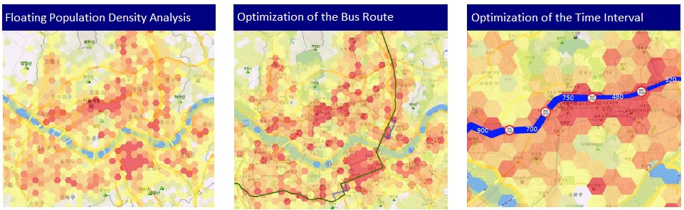
GOAL OF ANALYSIS
Analysis Software
Subject of Analysis
Analysis Process
Analysis Spatial Density of Foreign Tourists in Seoul City
Analysis Spatial Density of Foreign Tourists in Principal Areas
Applications
Seoul City’s OWL BUS

Slide 6
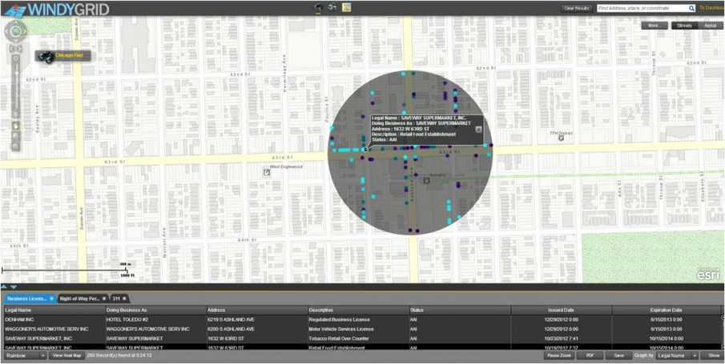
GOAL OF ANALYSIS
Analysis Software
Subject of Analysis
Analysis Process
Analysis Spatial Density of Foreign Tourists in Seoul City
Analysis Spatial Density of Foreign Tourists in Principal Areas
Applications
Crime Prediction

Slide 7
GOAL OF ANALYSIS
Analysis Software
Subject of Analysis
Analysis Process
Analysis Spatial Density of Foreign Tourists in Seoul City
Analysis Spatial Density of Foreign Tourists in Principal Areas
Applications
Where
ANALYSIS OF
OF FOREIGN TOURISTS IN SEOUL CITY
Roaming Big Data of Foreign Tourists
FLOATING POPOULATION DENSITY
Which Country
>>
+
>>
>>
GIS
(Geographic Information System)
When
Applications

Slide 8
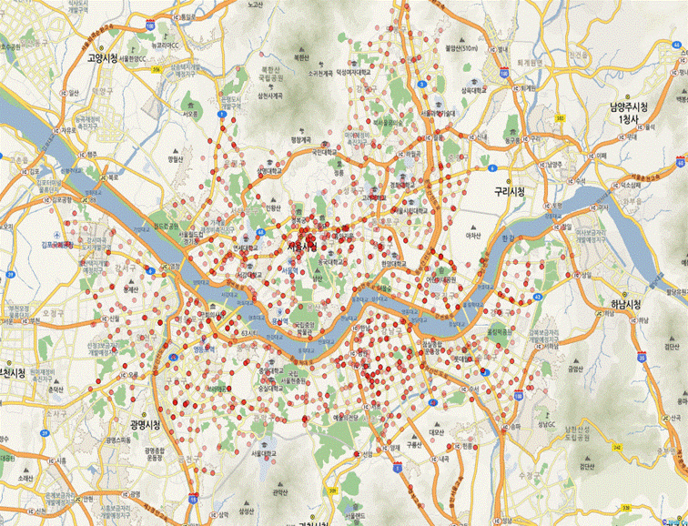
Goal of Analysis
SUBJECT OF ANALYSIS
Analysis Software
Analysis Process
Analysis Spatial Density of Foreign Tourists in Seoul City
Analysis Spatial Density of Foreign Tourists in Principal Areas
Applications
NUMBER OF
ANALYSIS SUBJECTS
1,774,618
TARGET AREA
Seoul City
NUMBER OF
TARGET POINTS
1,560

Slide 9
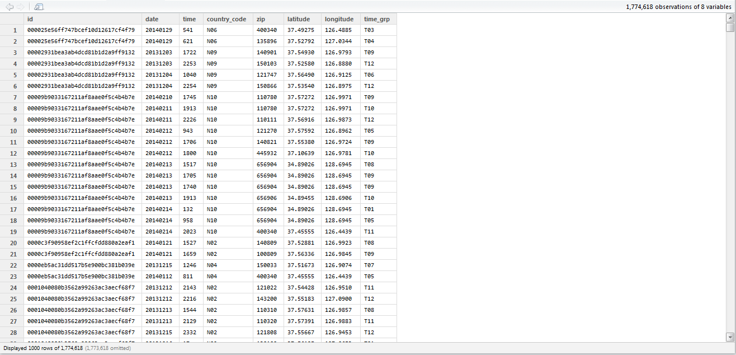
Goal of Analysis
SUBJECT OF ANALYSIS
Analysis Software
Analysis Process
Analysis Spatial Density of Foreign Tourists in Seoul City
Analysis Spatial Density of Foreign Tourists in Principal Areas
Applications
TARGET AREA
Seoul City
NUMBER OF
ANALYSIS SUBJECTS
1,774,618
NUMBER OF
TARGET POINTS
1,560

Slide 10
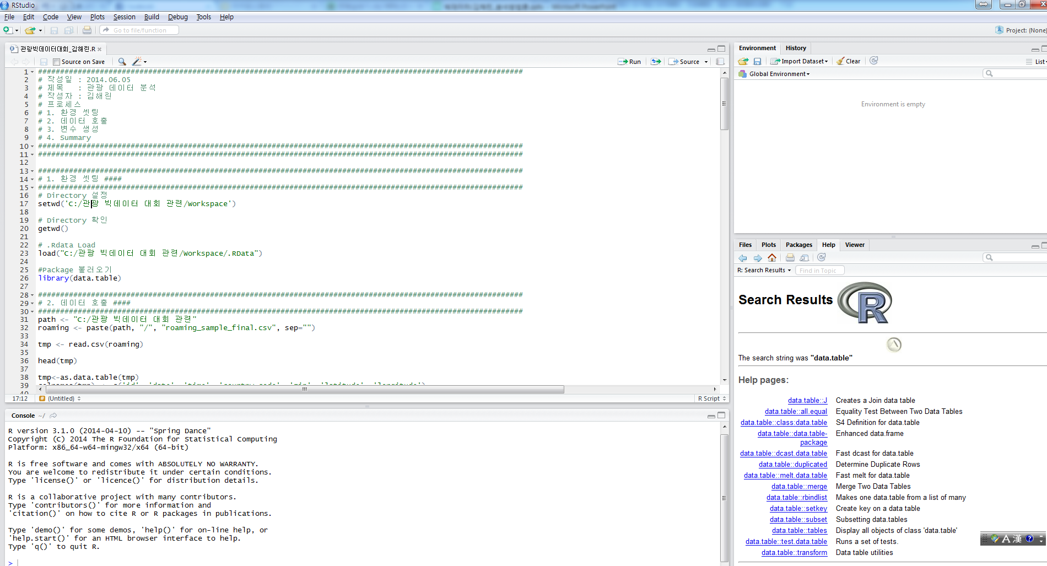
Goal of Analysis
Subject of Analysis
ANALYSIS SOFTWARE
Analysis Process
Analysis Spatial Density of Foreign Tourists in Seoul City
Analysis Spatial Density of Foreign Tourists in Principal Areas
Applications
R-Studio

Slide 11
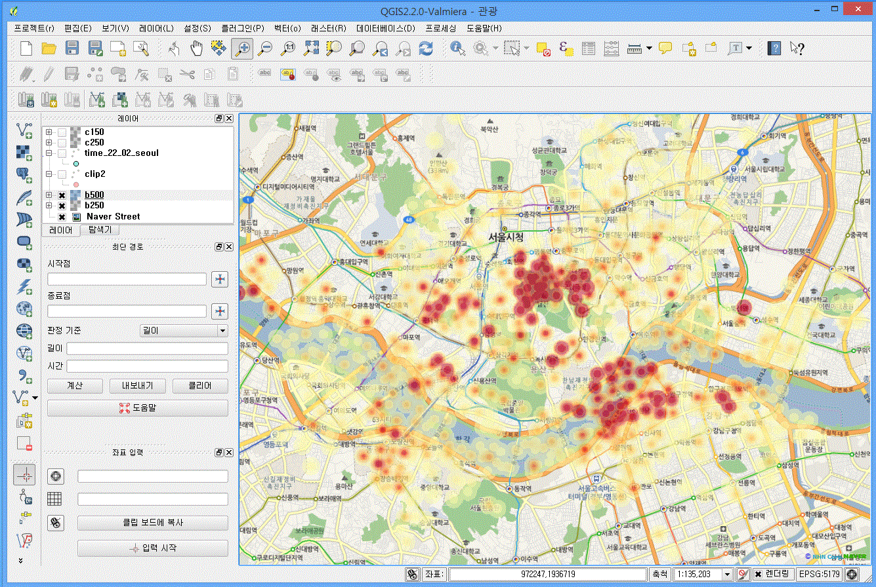
Goal of Analysis
Subject of Analysis
ANALYSIS SOFTWARE
Analysis Process
Analysis Spatial Density of Foreign Tourists in Seoul City
Analysis Spatial Density of Foreign Tourists in Principal Areas
Applications
QGIS: Open Source GIS Software

Slide 12
Goal of Analysis
Analysis Software
Subject of Analysis
ANALYSIS PROCESS
Analysis Spatial Density of Foreign Tourists in Seoul City
Analysis Spatial Density of Foreign Tourists in Principal Areas
Applications
Open CSV format data
WORKSPACE
SETTING
IMPORTING DATA
VARIABLES SETTING
Set working directory
Install packages
Set variables for analysis

Slide 13
Goal of Analysis
Analysis Software
Subject of Analysis
ANALYSIS PROCESS
Analysis Spatial Density of Foreign Tourists in Seoul City
Analysis Spatial Density of Foreign Tourists in Principal Areas
Applications
Visualize the analysis results
ANALYSIS
MATCH
GIS
VISUALIZATION
Match and sample spatial data
Create data for analysis
Conduct analysis

Slide 14
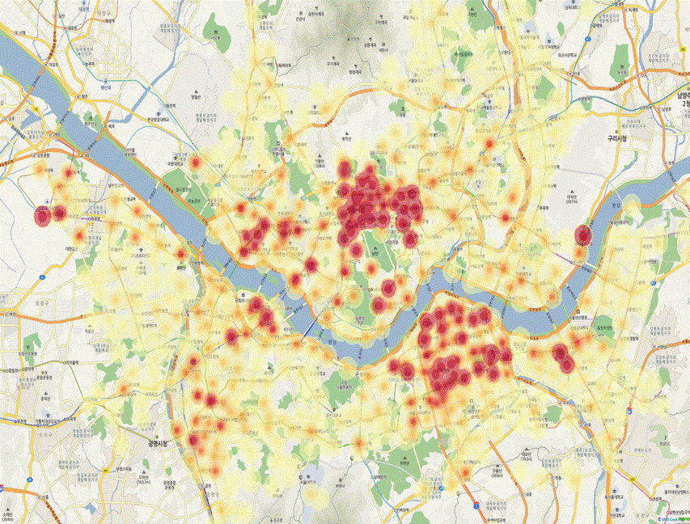
Goal of Analysis
Analysis Software
Subject of Analysis
Analysis Process
Analysis Spatial Density of Foreign Tourists in Seoul City
Analysis Spatial Density of Foreign Tourists in Principal Areas
Applications
Cumulative Number of Tourists
1,774,618

Slide 15
Goal of Analysis
Analysis Software
Subject of Analysis
Analysis Process
Analysis Spatial Density of Foreign Tourists in Seoul City
Analysis Spatial Density of Foreign Tourists in Principal Areas
Applications
Density Analysis(Nation)
Country | Cumulative Number of Tourists | Percentage | Rank
N01 | 800,937 | 45.13% | 1
N02 | 555,390 | 31.30% | 2
N03 | 70,457 | 3.97% | 6
N04 | 76,887 | 4.33% | 4
N05 | 5,765 | 0.32% | 10
N06 | 76,736 | 4.32% | 5
N07 | 34,522 | 1.95% | 7
N08 | 17,327 | 0.98% | 9
N09 | 32,605 | 1.84% | 8
N10 | 103,992 | 5.86% | 3
Total | 1,774,618 | 100.00%

Slide 16
Goal of Analysis
Analysis Software
Subject of Analysis
Analysis Process
Analysis Spatial Density of Foreign Tourists in Seoul City
Analysis Spatial Density of Foreign Tourists in Principal Areas
Applications
Density Analysis(Time)
Time Period | Cumulative Number of Tourists | Percentage | Rank
00~02 | 37,410 | 2.11% | 9
02~04 | 12,109 | 0.68% | 11
04~06 | 10,955 | 0.62% | 12
06~08 | 37,094 | 2.09% | 10
08~10 | 136,131 | 7.67% | 7
10~12 | 243,752 | 13.74% | 4
12~14 | 250,734 | 14.13% | 3
14~16 | 255,606 | 14.40% | 2
16~18 | 276,330 | 15.57% | 1
18~20 | 231,408 | 13.04% | 5
20~22 | 169,602 | 9.56% | 6
22~24 | 113,487 | 6.40% | 8
Total | 1,774,618 | 100.00%

Slide 17
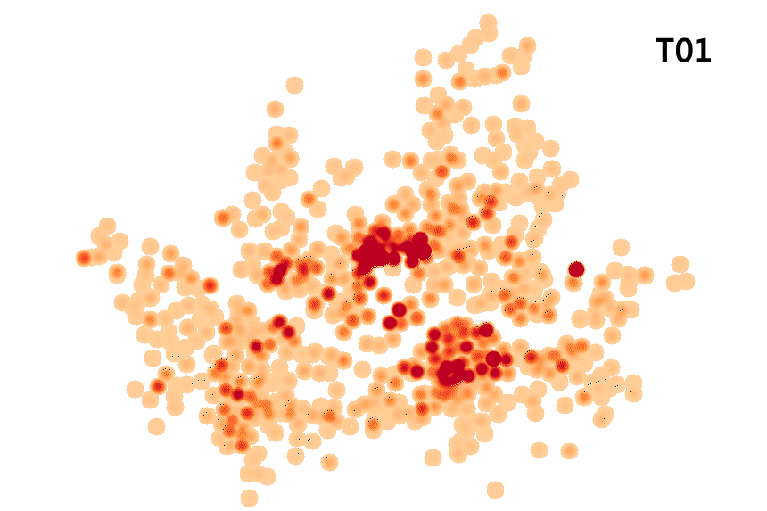
Goal of Analysis
Analysis Software
Subject of Analysis
Analysis Process
Analysis Spatial Density of Foreign Tourists in Seoul City
Analysis Spatial Density of Foreign Tourists in Principal Areas
Applications
Density Analysis(Time)

Slide 18
Goal of Analysis
Analysis Software
Subject of Analysis
Analysis Process
Analysis Spatial Density of Foreign Tourists in Seoul City
Analysis Spatial Density of Foreign Tourists in Principal Areas
Applications
Area | Cumulative Number of Tourists | Country |  |  |  |  |  |  |  |  |  | Time Period
 |  | N01 | N02 | N03 | N04 | N05 | N06 | N07 | N08 | N09 | N10 | 0~2 | 2~4 | 4~6 | 6~8 | 8~10 | 10~12 | 12~14 | 14~16 | 16~18 | 18~20 | 20~22 | 22~24
Myeongdong | 74,764 | 44,175 | 19,215 | 1,599 | 241 | 72 | 3,276 | 1,264 | 304 | 1,030 | 3,588 | 719 | 128 | 114 | 5,392 | 2,675 | 8,013 | 10,423 | 12,976 | 15,665 | 13,235 | 7,418 | 2,859
Dongdaemun market | 40,759 | 25,176 | 7,772 | 3,809 | 157 | 11 | 1,560 | 650 | 67 | 360 | 1,197 | 3,853 | 1,830 | 806 | 462 | 1,222 | 2,920 | 3,484 | 3,975 | 4,788 | 4,779 | 6,072 | 6,568
Deoksu Palace (City Hall) | 19,763 | 5,152 | 6,556 | 431 | 864 | 180 | 2,627 | 387 | 249 | 261 | 3,056 | 643 | 171 | 160 | 613 | 2,178 | 2,598 | 2,070 | 2,176 | 2,811 | 2,495 | 2,095 | 1,753
COEX | 17,475 | 5,651 | 5,318 | 814 | 919 | 165 | 1,670 | 372 | 285 | 213 | 2,068 | 582 | 212 | 159 | 525 | 1,555 | 2,497 | 2,246 | 2,078 | 2,493 | 2,031 | 1,603 | 1,494
Lotte world | 16,226 | 11,598 | 1,102 | 679 | 189 | 28 | 486 | 544 | 73 | 131 | 1,396 | 56 | 16 | 20 | 73 | 427 | 1,835 | 2,376 | 3,140 | 3,884 | 2,954 | 1,200 | 245
Insadong | 10,851 | 3,805 | 3,524 | 539 | 240 | 118 | 592 | 372 | 139 | 323 | 1,199 | 264 | 97 | 51 | 185 | 816 | 1,782 | 1,590 | 1,602 | 1,498 | 1,206 | 1,019 | 741
Garosu-gil | 8,697 | 3,944 | 2,560 | 329 | 193 | 23 | 759 | 99 | 121 | 148 | 521 | 180 | 52 | 35 | 68 | 353 | 857 | 1,182 | 1,529 | 1,785 | 1,359 | 845 | 452
Sungryemun | 8,518 | 2,151 | 4,148 | 452 | 38 | 4 | 589 | 260 | 70 | 100 | 706 | 170 | 53 | 19 | 70 | 499 | 1,246 | 1,579 | 1,602 | 1,412 | 896 | 526 | 446
Namsan Hanok Village | 8,459 | 3,697 | 2,688 | 357 | 157 | 17 | 599 | 297 | 76 | 76 | 495 | 289 | 76 | 57 | 209 | 1,164 | 903 | 903 | 1,043 | 1,251 | 946 | 881 | 782
Apgujeong | 6,654 | 3,939 | 1,337 | 89 | 427 | 26 | 341 | 63 | 49 | 44 | 339 | 99 | 49 | 29 | 111 | 407 | 1,020 | 1,018 | 1,077 | 1,069 | 897 | 545 | 333
Itaewon | 6,653 | 682 | 1,643 | 301 | 420 | 68 | 1,654 | 240 | 141 | 109 | 1,395 | 321 | 101 | 58 | 202 | 669 | 725 | 635 | 525 | 774 | 972 | 857 | 814
Gyeongbok Palace | 6,353 | 4,138 | 784 | 420 | 61 | 3 | 261 | 181 | 14 | 167 | 324 | 21 | 6 | 5 | 16 | 460 | 1,677 | 1,594 | 1,250 | 584 | 513 | 190 | 37
Gangnam Station | 5,835 | 2,277 | 1,697 | 183 | 173 | 17 | 427 | 129 | 113 | 150 | 669 | 195 | 57 | 36 | 89 | 370 | 742 | 802 | 740 | 901 | 785 | 626 | 492
Hongik University Entrance | 4,674 | 1,873 | 1,021 | 428 | 92 | 3 | 345 | 153 | 40 | 368 | 351 | 168 | 42 | 28 | 42 | 184 | 463 | 632 | 604 | 734 | 732 | 619 | 426

Slide 19
Goal of Analysis
Analysis Software
Subject of Analysis
Analysis Process
Analysis Spatial Density of Foreign Tourists in Seoul City
Analysis Spatial Density of Foreign Tourists in Principal Areas
Applications
Area | Cumulative Number of Tourists | Country |  |  |  |  |  |  |  |  |  | Time Period
 |  | N01 | N02 | N03 | N04 | N05 | N06 | N07 | N08 | N09 | N10 | 0~2 | 2~4 | 4~6 | 6~8 | 8~10 | 10~12 | 12~14 | 14~16 | 16~18 | 18~20 | 20~22 | 22~24
Myeongdong
Dongdaemun market
Deoksu Palace (City Hall)
COEX |  |  |  |  |  |  |  |  |  |  | `
Lotte world
Insadong
Garosu-gil
Sungryemun
Namsan Hanok Village
Apgujeong
Itaewon
Gyeongbok Palace
Gangnam Station
Hongik University Entrance

Slide 20
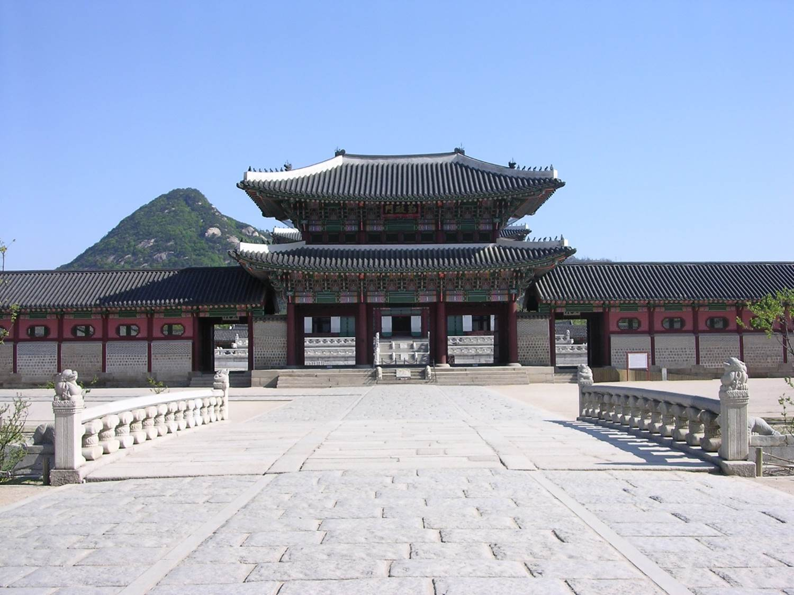
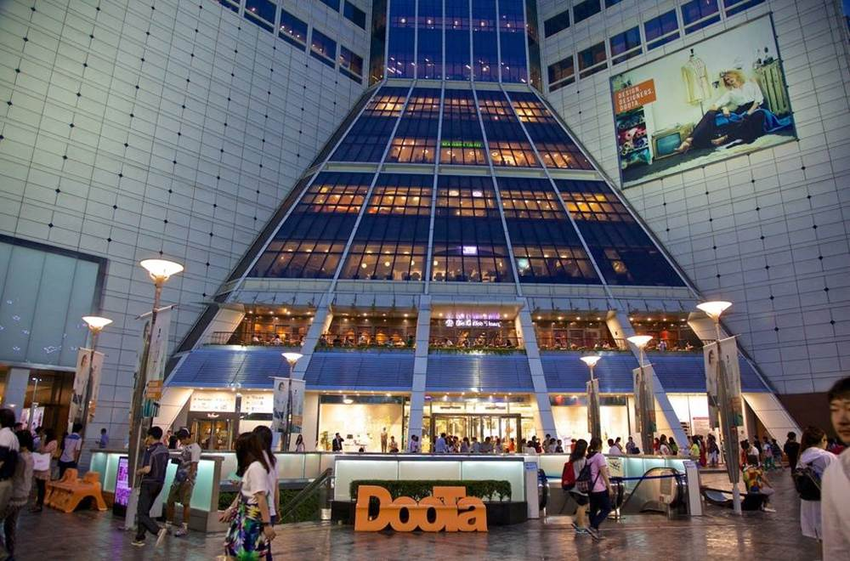
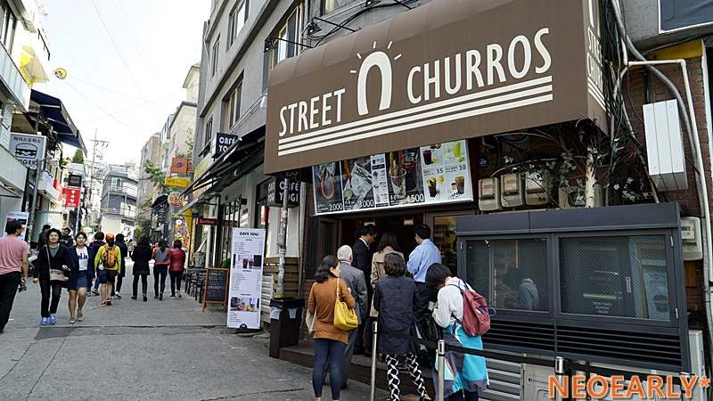
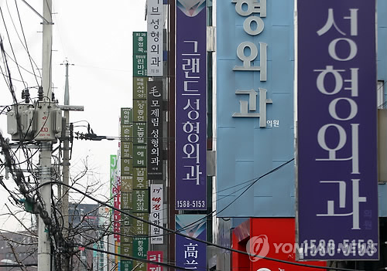
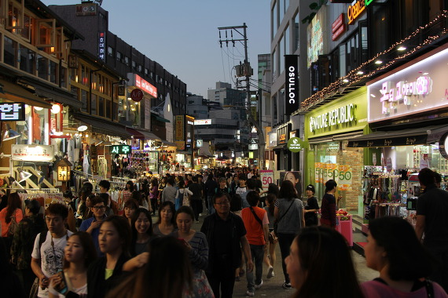
Goal of Analysis
Analysis Software
Subject of Analysis
Analysis Process
Analysis Spatial Density of Foreign Tourists in Seoul City
Analysis Spatial Density of Foreign Tourists in Principal Areas
Applications
GYEONGBOK PALACE
DONGDAEMUN
MARKET
ITAEWON
APGUJEONG-DONG
HONGIK UNIVERSITY ENTRANCE

Slide 21

1
Gyeongbok Palace

Slide 22
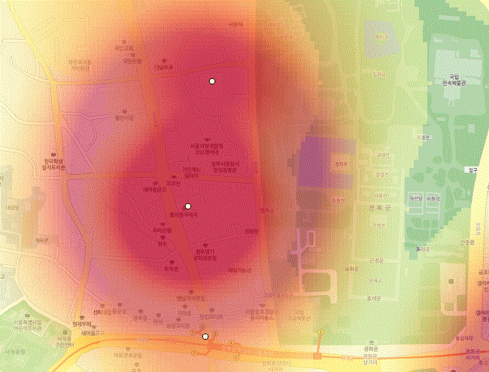
Goal of Analysis
Analysis Software
Subject of Analysis
Analysis Process
Analysis Spatial Density of Foreign Tourists in Seoul City
Analysis Spatial Density of Foreign Tourists in Principal Areas
Applications
GYEONGBOK PALACE(QGIS)

Slide 23
NUMBER OF VISITORS
NUMBER OF VISITORS

Slide 24

2
Dongdaemun Market

Slide 25
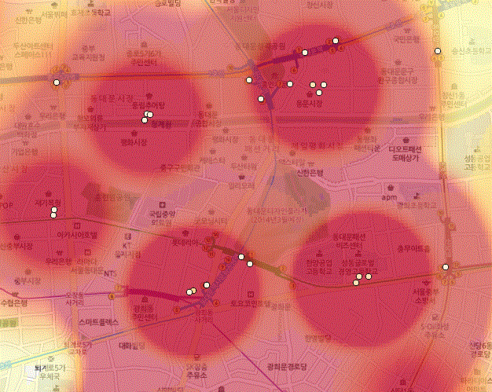
Goal of Analysis
Analysis Software
Subject of Analysis
Analysis Process
Analysis Spatial Density of Foreign Tourists in Seoul City
Analysis Spatial Density of Foreign Tourists in Principal Areas
Applications
DONGDAEMUN MARKET(QGIS)

Slide 26
NUMBER OF VISITORS
NUMBER OF VISITORS

Slide 27
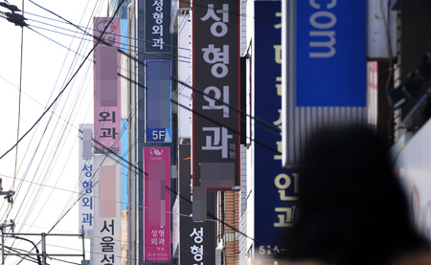
3
Apgujeong-dong

Slide 28
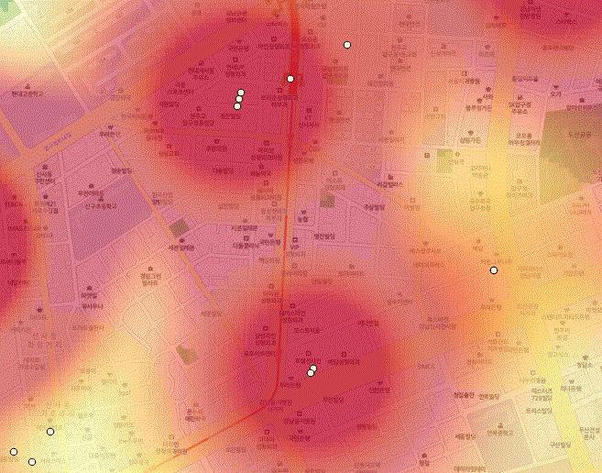
Goal of Analysis
Analysis Software
Subject of Analysis
Analysis Process
Analysis Spatial Density of Foreign Tourists in Seoul City
Analysis Spatial Density of Foreign Tourists in Principal Areas
Applications
APGUJEONG-DONG(QGIS)

Slide 29
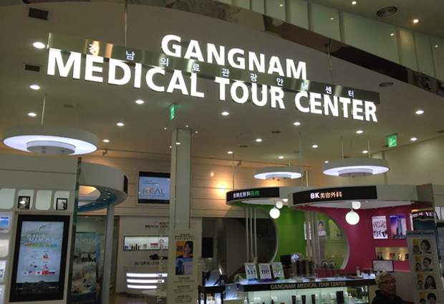
Goal of Analysis
Analysis Software
Subject of Analysis
Analysis Process
Analysis Spatial Density of Foreign Tourists in Seoul City
Analysis Spatial Density of Foreign Tourists in Principal Areas
Applications

Slide 30
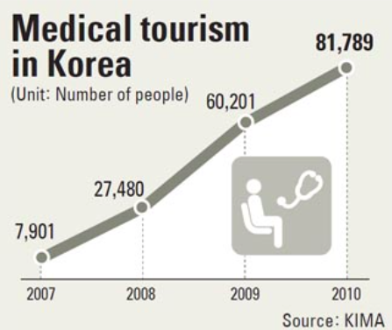
Goal of Analysis
Analysis Software
Subject of Analysis
Analysis Process
Analysis Spatial Density of Foreign Tourists in Seoul City
Analysis Spatial Density of Foreign Tourists in Principal Areas
Applications

Slide 32
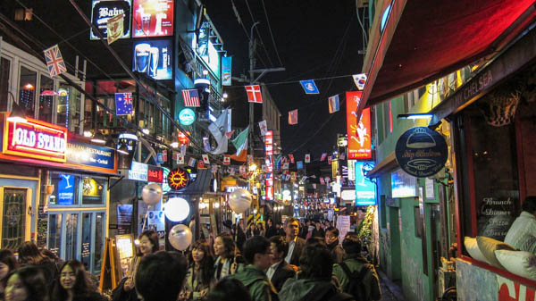
4
Itaewon

Slide 33
21%
1395
24.7%
N10
1643
N02
N06
24.8%
1654

Slide 34
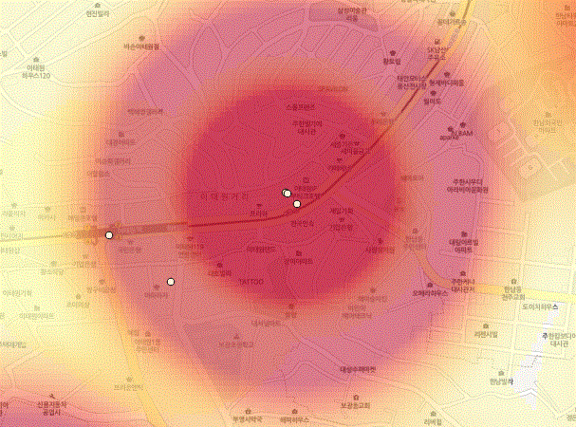
Goal of Analysis
Analysis Software
Subject of Analysis
Analysis Process
Analysis Spatial Density of Foreign Tourists in Seoul City
Analysis Spatial Density of Foreign Tourists in Principal Areas
Applications
ITAEWON(QGIS)

Slide 35
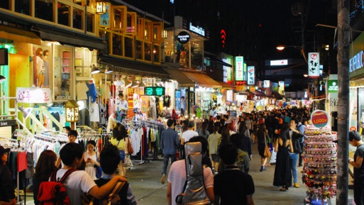
5
Hongik University Entrance

Slide 36
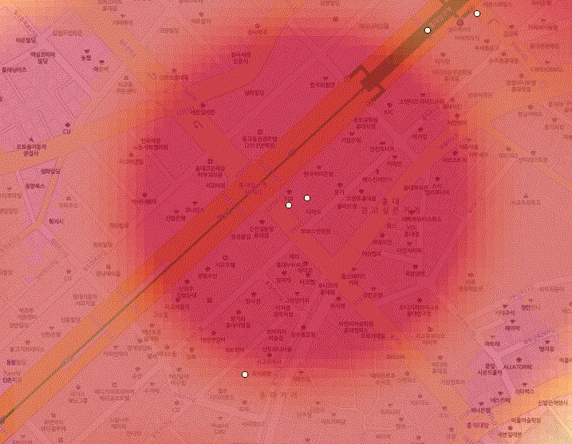
Goal of Analysis
Analysis Software
Subject of Analysis
Analysis Process
Analysis Spatial Density of Foreign Tourists in Seoul City
Analysis Spatial Density of Foreign Tourists in Principal Areas
Applications
HONGIK UNIVERSITY(QGIS)

Slide 38

Goal of Analysis
Analysis Software
Subject of Analysis
Analysis Process
Analysis Spatial Density of Foreign Tourists in Seoul City
Analysis Spatial Density of Foreign Tourists in Principal Areas
Application
ADDITIONAL
TOURIST INFORMATION
CENTERS

Slide 39
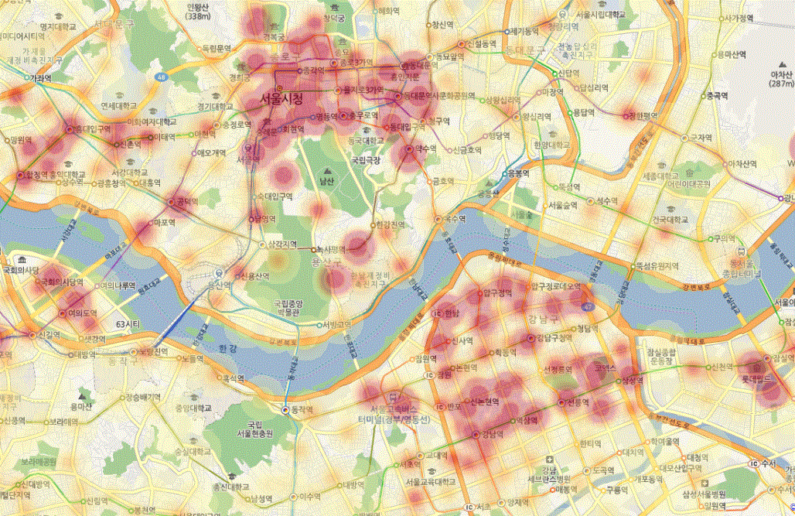
25 Tourist Information Centers

Slide 40
22 Tourist Information Centers concentrated in
GAGNGBUK Area

Slide 41
7 Tourist Information Centers

Slide 42
Yeouido
Garosu-gil
Gangnam Express Bus Terminal
COEX
Gangnam Station
Current Tourist Information Centers
New Tourist Information Centers

Slide 43

Goal of Analysis
Analysis Software
Subject of Analysis
Analysis Process
Analysis Spatial Density of Foreign Tourists in Seoul City
Analysis Spatial Density of Foreign Tourists in Principal Areas
Application
ROAD SIGNS
WITH FOREIGN LANGUAGES

Slide 44
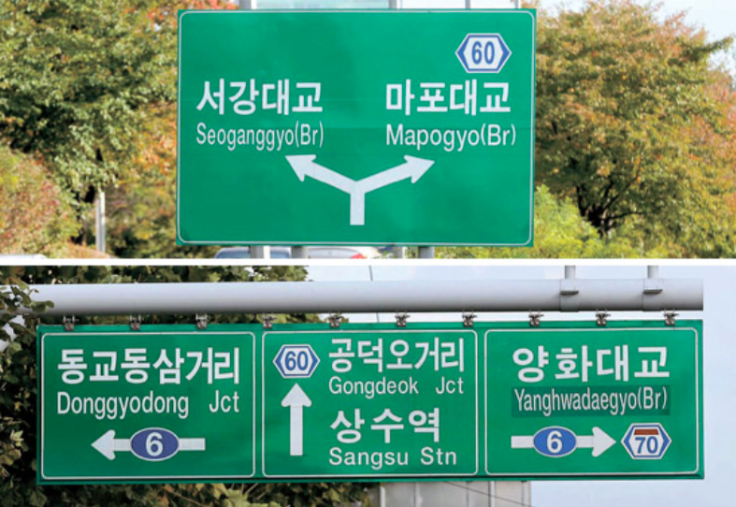
Goal of Analysis
Analysis Software
Subject of Analysis
Analysis Process
Analysis Spatial Density of Foreign Tourists in Seoul City
Analysis Spatial Density of Foreign Tourists in Principal Areas
Application
34%
21.3%
CHINA
JAPAN

Slide 45
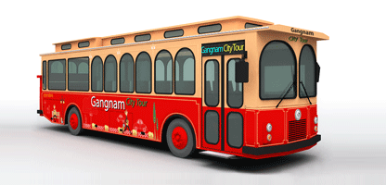
Goal of Analysis
Analysis Software
Subject of Analysis
Analysis Process
Analysis Spatial Density of Foreign Tourists in Seoul City
Analysis Spatial Density of Foreign Tourists in Principal Areas
Application
NEW ROUTE
for CITY TOUR BUS

Slide 46
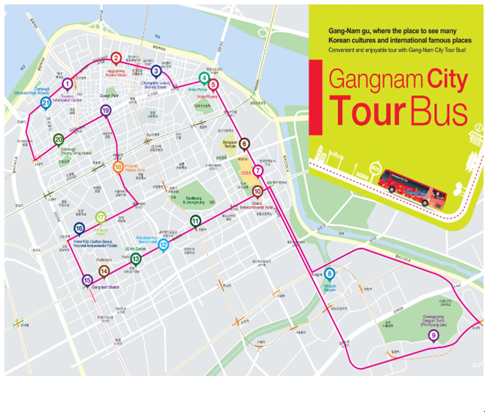
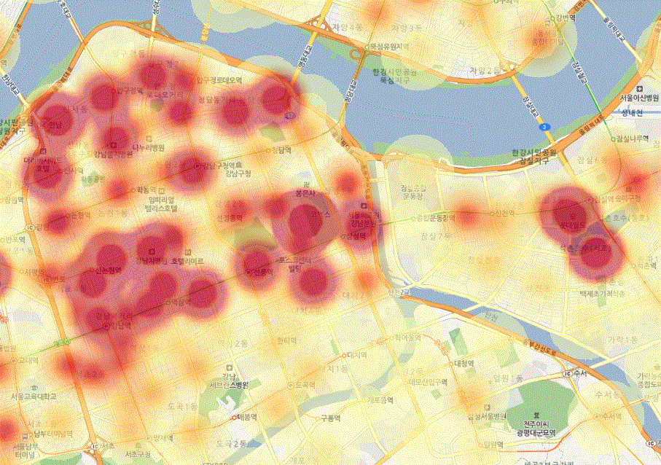
Goal of Analysis
Analysis Software
Subject of Analysis
Analysis Process
Analysis Spatial Density of Foreign Tourists in Seoul City
Analysis Spatial Density of Foreign Tourists in Principal Areas
Application
New Route of Gangnam City Tour Bus
>>

Slide 47

Goal of Analysis
Analysis Software
Subject of Analysis
Analysis Process
Analysis Spatial Density of Foreign Tourists in Seoul City
Analysis Spatial Density of Foreign Tourists in Principal Areas
Application
NIGHT
BUS SERVICE

Slide 48
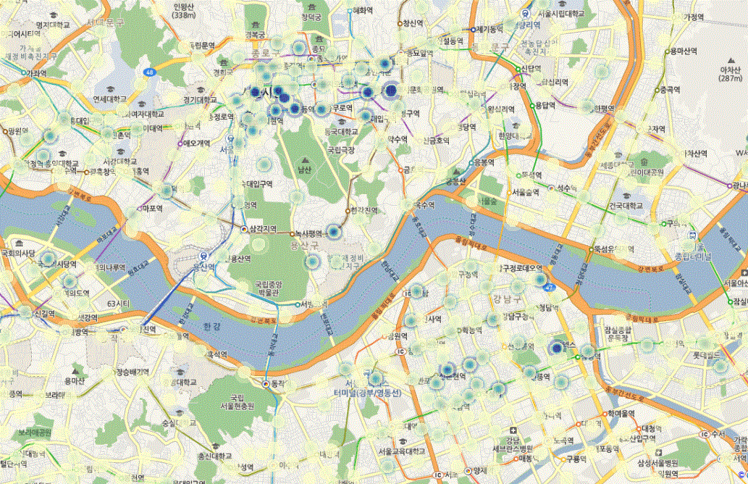
Goal of Analysis
Analysis Software
Subject of Analysis
Analysis Process
Analysis Spatial Density of Foreign Tourists in Seoul City
Analysis Spatial Density of Foreign Tourists in Principal Areas
Application
Night Bus Service
Dongdaemun
Hongik University Entrance
Sinchon
Myeongdong
Itaewon
COEX
Gangnam
Station

Slide 49
Thank You

